Slide 1
Organic Compounds

Slide 2

Chemistry Joke
Q: What did one charged atom say to the other?
A: I’ve got my “ion” you!!!

Slide 3

Organic Molecules
Generally, molecules that contain carbon are organic
  Some exceptions are carbonates (CO₃²⁻), cyanides (CN⁻), simple oxides of carbon (CO), as well as diamond and graphite
Diamond and graphite are allotropes of carbon—that is, they are both carbon, but in very different structural forms.

Slide 4
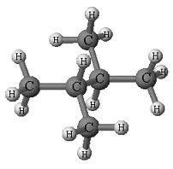
Organic Molecules / Hydrocarbons
Hydrocarbons are organic molecules that contain only carbon and hydrogen.
Methane, CH₄, is the simplest hydrocarbon.

Slide 5
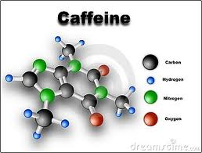
Organic Molecules
Other organic molecules may contain many other elements including halogens, metals, sulfur, oxygen, phosphorus, or nitrogen.

Slide 6
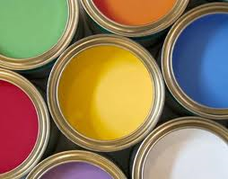
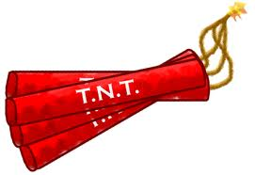
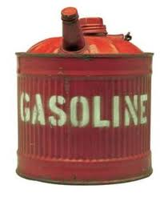
Organic Compounds
Organic compounds make up the whole or part of innumerable products—some natural and some synthetic.
  Plastics
  Explosives
  Paints
  Petrochemicals-derived from petroleum, but are used to make synthetics such as plastic

Slide 7
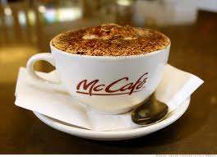
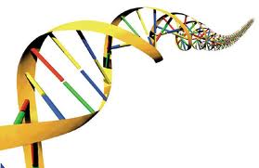
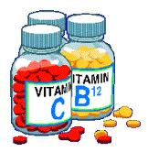
Organic Compounds
  Foods
    Starch, sugar, caffeine
  Biological Compounds
    Amino acids, Proteins, DNA, RNA, cellulose, hormones, cholesterol
  Pharmaceuticals
    aspirin, vitamins, insulin

Slide 8

Structure
Organic molecules are constructed as carbon atoms form 4 stable, covalent bonds.

Slide 9



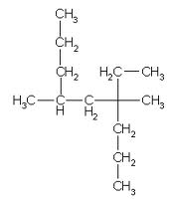
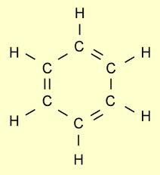
Structure
These carbon structures can have single, double, or triple bonds.
They can be straight chains or chains with branches.
They can also form rings.

Slide 10
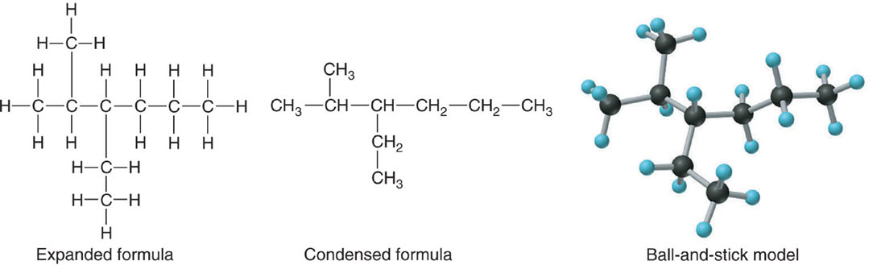
Alkanes: Saturated Hydrocarbons
Remember:
  Hydrocarbons are molecules composed of C & H.
  Each carbon atom forms 4 chemical bonds
A saturated hydrocarbon is one where all C - C bonds are “single” bonds & the molecule contains the maximum number of H-atoms.
Saturated hydrocarbons are called ALKANES

Slide 11
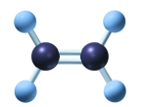

Alkenes and Alkynes
Alkenes contain a double bond between adjacent carbon atoms.
Alkynes contain a triple bond.
These hydrocarbons are called unsaturated because all of the bonds are NOT single bonds.
Copyright © 2005 by Pearson Education, Inc.
Publishing as Benjamin Cummings

Slide 12

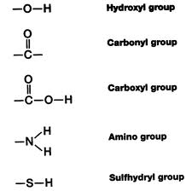

Functional Groups
Carbon atoms bound to each other form a backbone to which other atoms or groups of atoms are attached.
These groups of atoms are called functional groups.
Aldehyde group

Slide 13
Build the Structure
Compound | Structure | Compound | Structure
CH₄ (methane) |  | CH₃CH₂OH (ethanol)
C₂H₆ (ethane) |  | CH₂O (formaldehyde)
C₂H₄ (ethene) |  | C₆H₆ (benzene)
C₂H₂ (acetylene) |  | CH₃COOH (acetic acid)

Slide 14
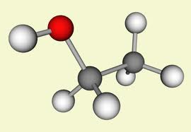

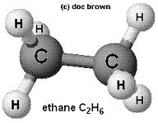
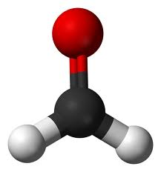
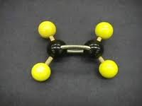
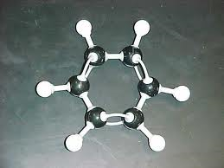
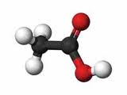

Structure
CH₃CH₂OH
CH₂O
C₆H₆
CH₃COOH
CH₄
C₂H₆
C₂H₄
C₂H₂
Methane
Ethanol
Ethane
Formaldehyde
Ethene
Benzene
Acetylene
Acetic Acid

Slide 15
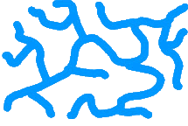
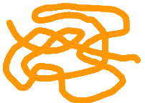
Structure / Polymers
When organic molecules form long chains with repeating structural units, they are called polymers.
These chains are flexible—the bonds in the backbone can swivel like paperclips hooked together.

Slide 16
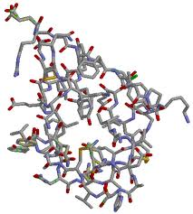
Structure / Polymers
Insulin
(a protein)
Polymers can be natural or synthetic
Proteins, cellulose, RNA, amino acids and DNA are examples of natural organic polymers.
Plastic, nylon, and Kevlar are examples of synthetic organic polymers.

Slide 17
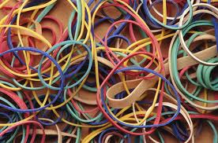

Polymers
Rubber

Slide 18
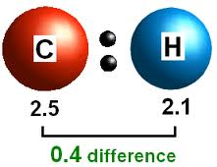
Properties of Organic Compounds
Covalent bonds
Low melting and boiling points
Often liquids or gases at room temperature and pressure

Slide 19
Chemistry Joke
Q: What did the bartender say when oxygen, hydrogen, sulfur, sodium, and phosphorus walked in?
A: OH SNaP!!!

