Slide 1

Atomic Theory

Slide 2
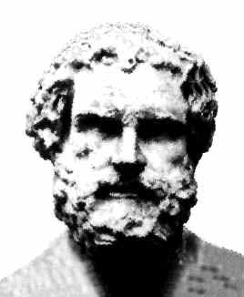
The History of the Atom
Original idea – Greek
  Democritus – 460 B.C.
    Thought there were ‘indivisible particles’ that everything was made from
    Called them ATOMS

Slide 3
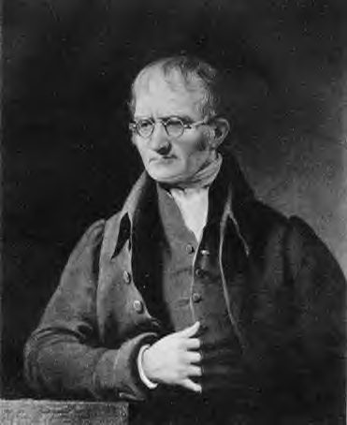
Then comes…
John Dalton
He was a British school teacher.

Slide 4
Dalton’s Atomic Theory (~1803)
All matter is made of tiny, indivisible particles called atoms.
Atoms of the same element are identical.
Atoms of different elements combine in whole number ratios to form compounds.
Chemical reactions involve the rearrangement of atoms.

Slide 5
+
→
+
Nothing is created or destroyed, just rearranged…
Law of Conservation of Mass

Slide 6
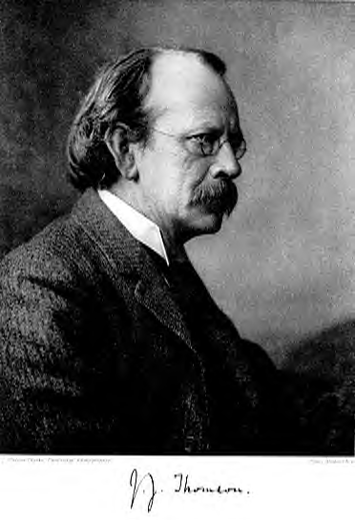
J. J. Thomson

Slide 7
J.J. Thomson—Discovery of the Electron (~ 1897)
Used a piece of equipment called a cathode ray tube
Voltage Source
-
+
Vacuum Tube
Metal Disks

Slide 8
Thomson’s Experiment
Voltage source
-
+
Passing an electric current through the tube creates a beam that moves from the negative to the positive end.

Slide 9
Voltage source
+
-
By adding a magnetic field he found that the particles of the beam were negatively charged, because they were attracted to the positive end of the magnetic field.

Slide 10
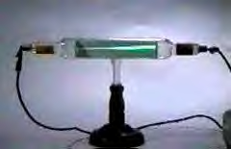

Slide 11
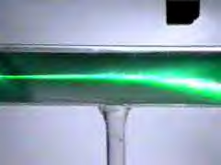

Slide 12
Thomson’s Model—Plum Pudding
The atom is a bunch of positive “stuff” likened to pudding with electrons scattered throughout like raisins

Slide 13
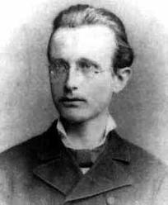
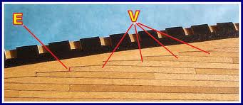
Max Planck—Quantum Nature of Energy (~ 1900)
  Energy can be only be measured in discreet units or “packets” called quanta
  Developed quantum mechanics
Mnemonic:
Think of the plank (Planck) of a ship—it’s a piece of a ship like a quantum is a piece of energy.

Slide 14
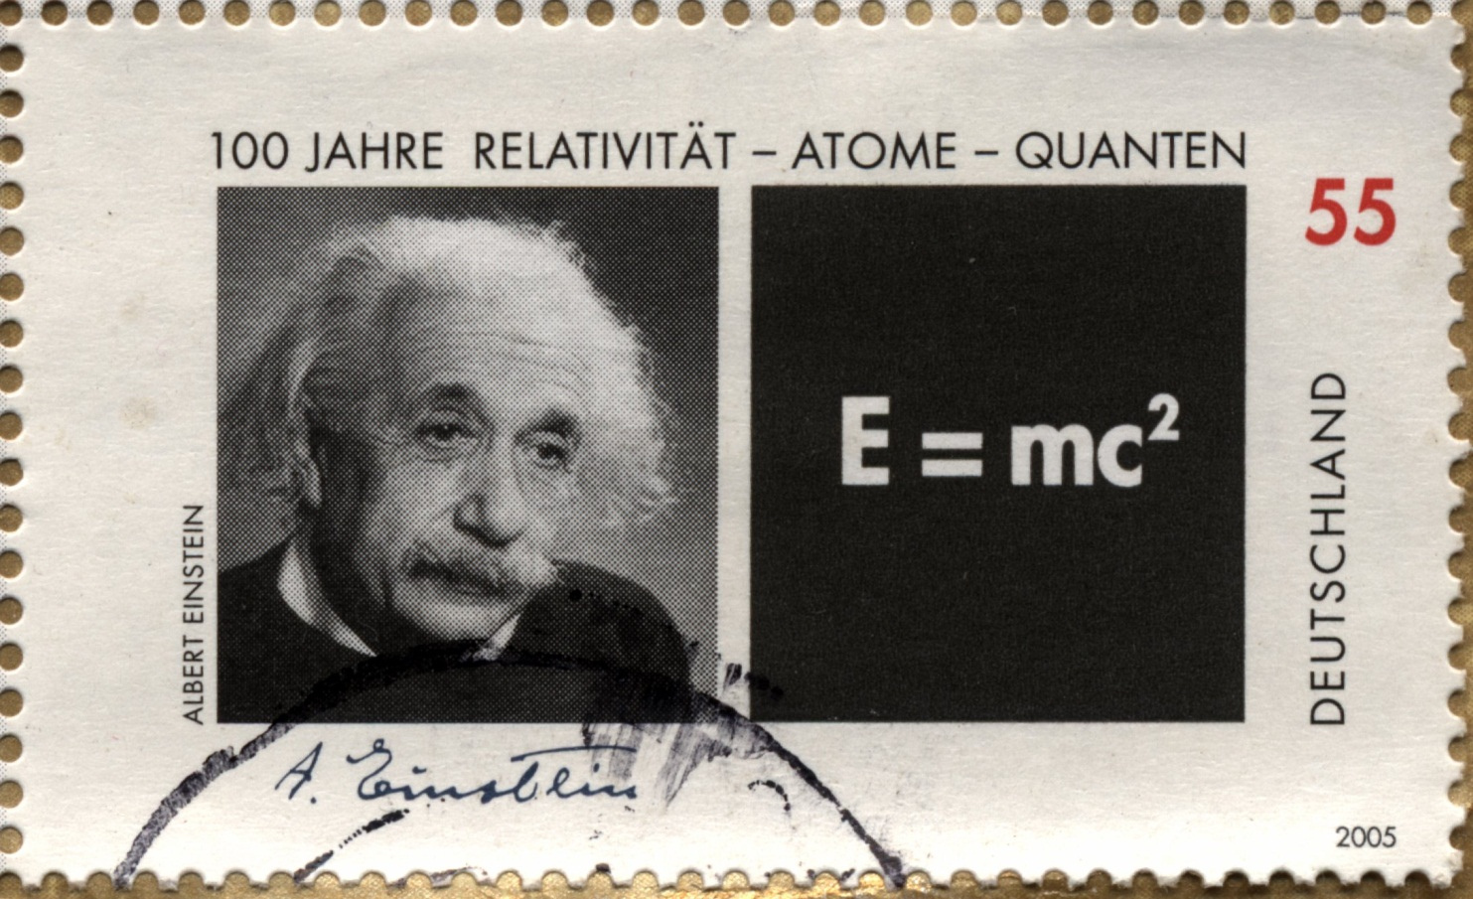
Albert Einstein (~ 1905)
  Theorized that light can behave as a particle called a photon

Slide 15
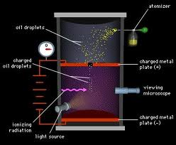
Robert Millikan (~ 1908)
  Discovered the exact charge of the electron using the Oil Drop Experiment
−1.602×10⁻¹⁹ Coulombs

Slide 16
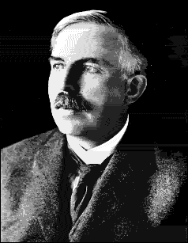
Ernest Rutherford

Slide 17
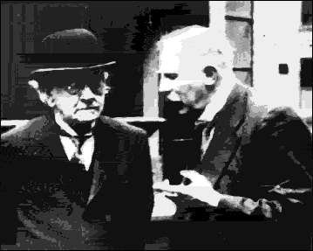
Rutherford—Discovery of Nucleus
(~ 1911)
Student of Thomson’s—believed in the plum pudding model of the atom.
Thomson and Rutherford

Slide 18
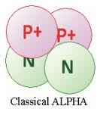
Rutherford’s Gold Foil Experiment
Used positively charged radioactive particles called alpha particles to probe the atom
Shot them at gold foil which can be made a few atoms thick
2+

Slide 19
Fluorescent
Screen
Lead block
Radium
Gold Foil
When the alpha particles hit the fluorescent screen, the screen would glow.

Slide 20
What he expected…
The alpha particles should pass through without changing direction very much.

Slide 21
Because…he thought the charges were evenly distributed throughout the atom.

Slide 22
What he got…

Slide 23
How he explained it:
The atom is mostly empty space.
It contains a small, dense, positive area at the center.
Alpha particles are deflected by this area if they get close enough.
+

Slide 24
+

Slide 25
Rutherford’s Model
A dense positive core in the atom
  Called the nucleus
Electrons move randomly around this core
Atom is mostly empty space
+

Slide 26

Other Scientists You Need to Know…
Listed Chronologically by Approximate Date of Contribution

Slide 27

Niels Bohr (~ 1912)
  Applied the concepts of Planck and Einstein to theorize that electrons are restricted to certain energy levels.
  They must travel in orbits around the nucleus
  Called the Planetary Model

Slide 28
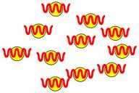
Louis de Broglie—Duality of Particles and Waves (~ 1924)
  Theorized that electrons can behave as both particles and waves

Slide 29

Werner Heisenberg (~ 1927)
  Uncertainty Principle: We cannot know both the position and the momentum of a quantum particle.

Slide 30
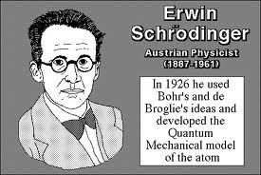
Erwin Schrodinger—Modern Mathematical Model (~ 1928)
Developed the model of the atom that we use today
Based on the idea of de Broglie that particles behave as waves—called wave mechanics
A mathematical model (difficult to picture!)
His model is called the Quantum Mechanical Model.

Slide 31

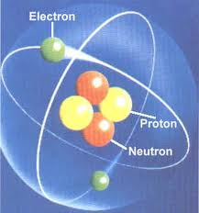
Finally…
James Chadwick (~ 1932)
  Discovered the neutron
Oops—Wrong Neutron!

Slide 32
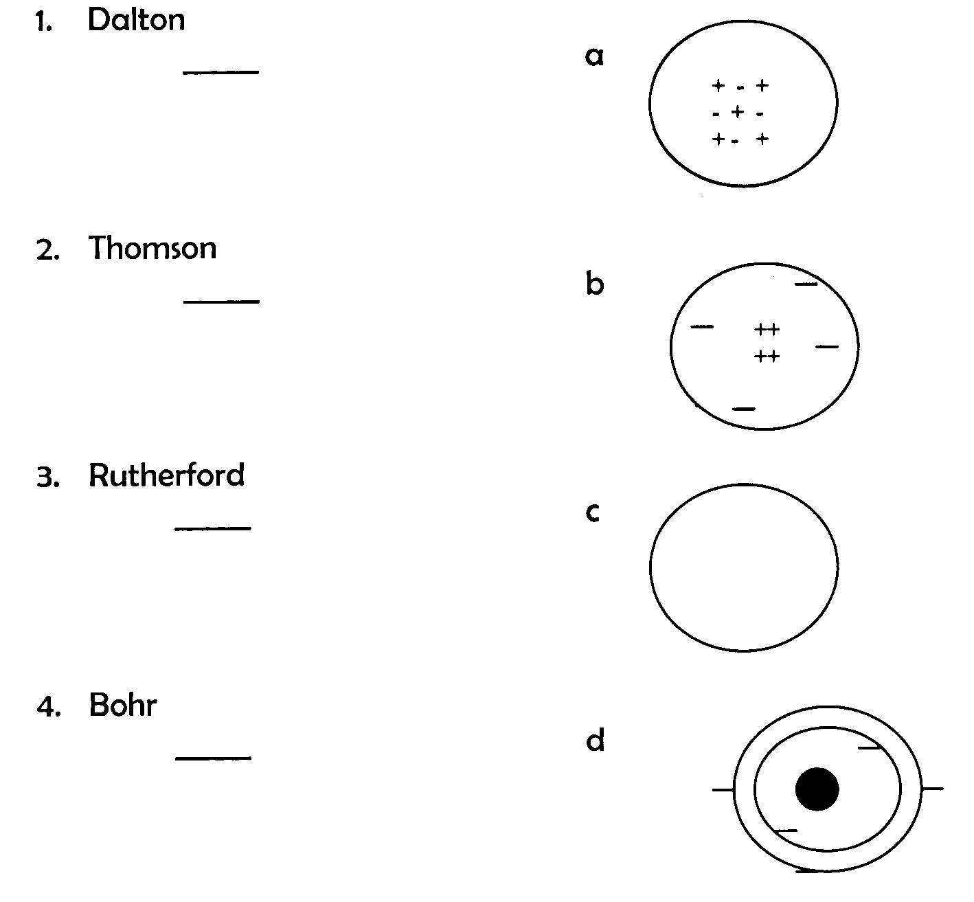
Which is Whose???

Slide 33
DETERMINED THE EXACT CHARGE OF AN ELECTRON USING THE OIL DROP EXPERIMENT
RUTHERFOD
PLANCK
MENDELEEV
MILLIKAN
DALTON
THOMSON

Slide 34
FIRST ATOMIC THEORY
RUTHERFORD
PLANCK
MENDELEEV
DALTON
THOMSON
HEISENBERG

Slide 35
DISCOVERED ELECTRON USING CATHODE RAY TUBE—PROPOSED PLUM PUDDING MODEL
RUTHERFORD
PLANCK
MENDELEEV
DALTON
THOMSON
HEISENBERG

Slide 36
UNCERTAINTY PRINCIPLE
RUTHERFORD
PLANCK
MENDELEEV
HEISENBERG
THOMSON
MILLIKAN

Slide 37
DISCOVERED NUCLEUS USING GOLD FOIL EXPERIMENT
RUTHERFORD
PLANCK
SHRODINGER
THOMSON
DALTON
CHADWICK

Slide 38
QUANTUM NATURE OF ENERGY
EINSTEIN
PLANCK
MENDELEEV
SHRODINGER
DE BROGLIE
HEISENBERG

Slide 39
PARTICLE AND WAVE DUALITY
MOSELEY
SCHRODINGER
EINSTEIN
DE BROGLIE
DEMOCRITUS
CHADWICK

Slide 40
PLANETARY MODEL
MOSELEY
SCHRODINGER
EINSTEIN
CHADWICK
BOHR
DE BROGLIE

Slide 41
MODERN PERIODIC TABLE—ARRANGED BY ATOMIC NUMBER
MOSELEY
SCHRODINGER
EINSTEIN
BOHR
DE BROGLIE
MENDELEEV

Slide 42
PUT THESE MODELS IN ORDER FROM EARLIEST TO LATEST
BOHR—PLANETARY
RUTHERFORD—NUCLEAR
SCHRODINGER—MATHEMATICAL
DALTON—INDIVISIBLE
THOMPSON—PLUM PUDDING

Slide 43
WHAT WAS THE NAME OF RUTHERFORD’S EXPERIMENT?

Slide 44
WHICH SCIENTIST USED A CATHODE RAY TUBE?

